Slide 1
THG Simulations
Project update
Week 5
??/08/2023
David Amorim

Slide 2
Overview
An extensive round of parameter scans was carried out, involving over 7000 simulation runs
considered Ar, Ne, Kr, Xe, He, N2, and N2O
beam powers: 75mW, 150mW, 200mW, 300mW, and 400mW
pressures: 0.1bar to 5.1bar in 0.1bar increments
density profiles: gradient and COMSOL
The scan outputs consisted of:
total UV energy & efficiency
UV pulse duration
UV output spectrum
Position in the cell of the UV energy peak
Caveat: the simulations used the ADK ionisation model instead of PPT!

Slide 3
Goals
Compare the COMSOL density model to the gradient density model and decide which one to use moving forward
SURELY COMSOL SHOULD BE TAKEN AS BEING MORE ACCURATE???
Analyse the relative performance of different gases as a general feasibility study
Identify combinations of pressure, beam power and gas that result in energetic sub-2fs UV pulses
These conditions can then be studied in more detail (using PPT ionisation, considering spatiotemporal profile…)

Slide 4
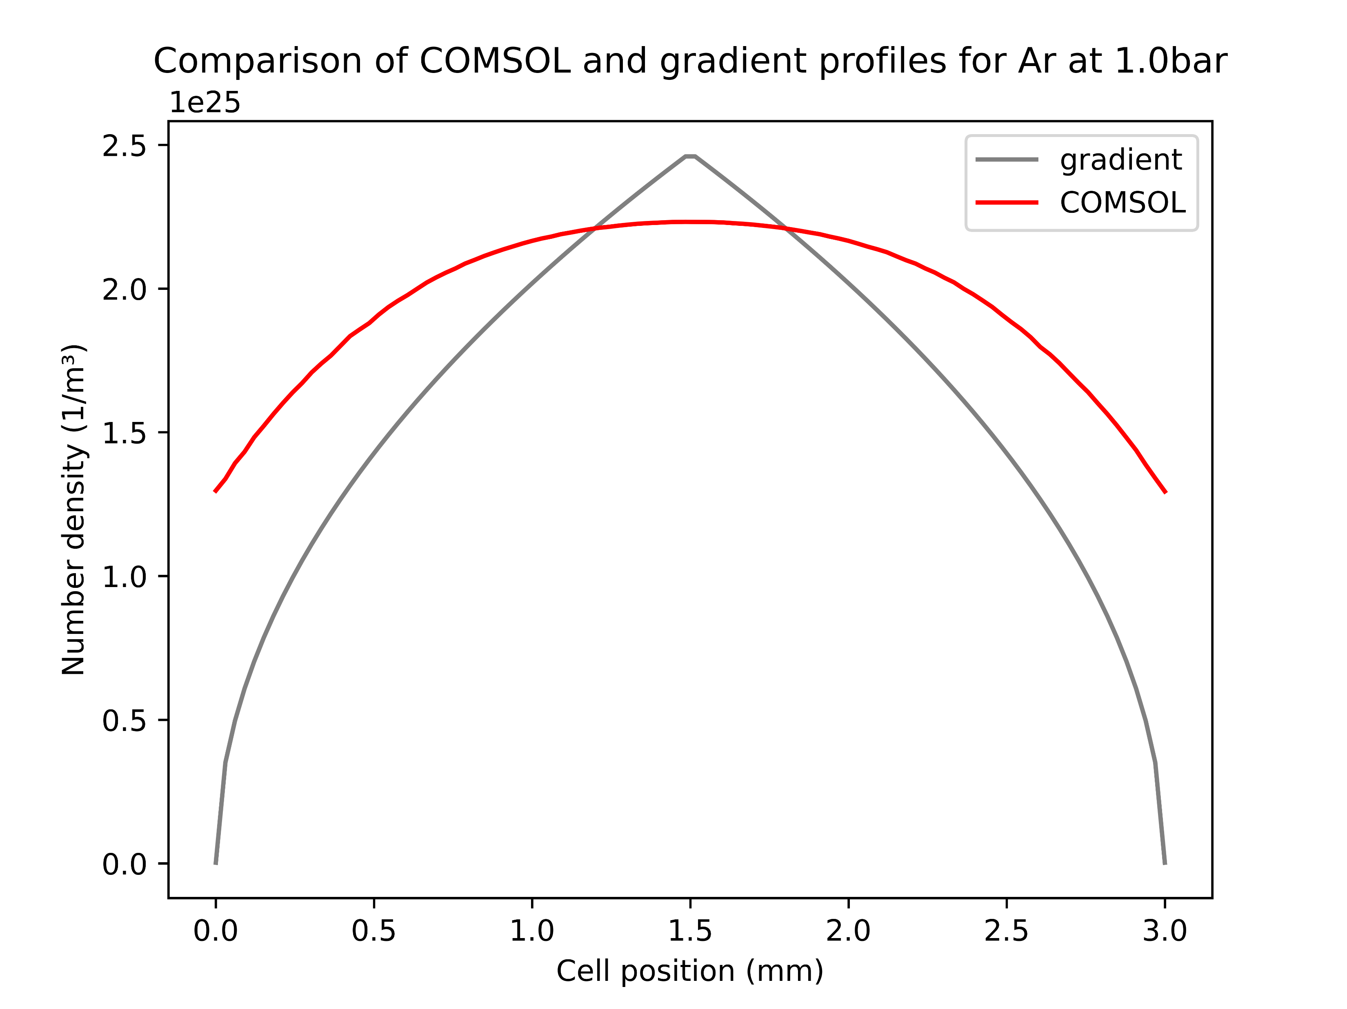
Comparison of COMSOL and gradient profiles
Gradient profile has a higher peak and steeper drop-off than COMSOL
This is difference is (qualitatively) unchanged when varying pressures or gases
Note: COMSOL model based on Argon
Overall, good agreement of the two models

Slide 5
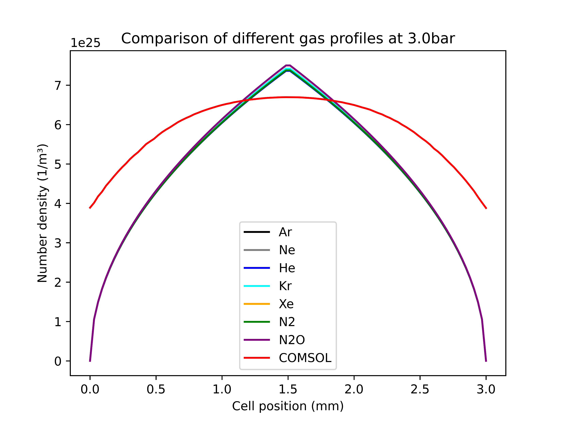
Comparison of COMSOL and gradient profiles
The fact that the COMSOL simulations are only based on Argon does not seem to be an issue
At the given pressures there is barely any difference in the gas density profiles
Thus, the COMSOL model was also used for the other gases in the parameter scans

Slide 6
General trend: shortest pulses occur for very low pressures and hence very low UV energies
Identify main differences between COMSOL and grad models
Then also look at spectra [just nit pick individual case]

Slide 7
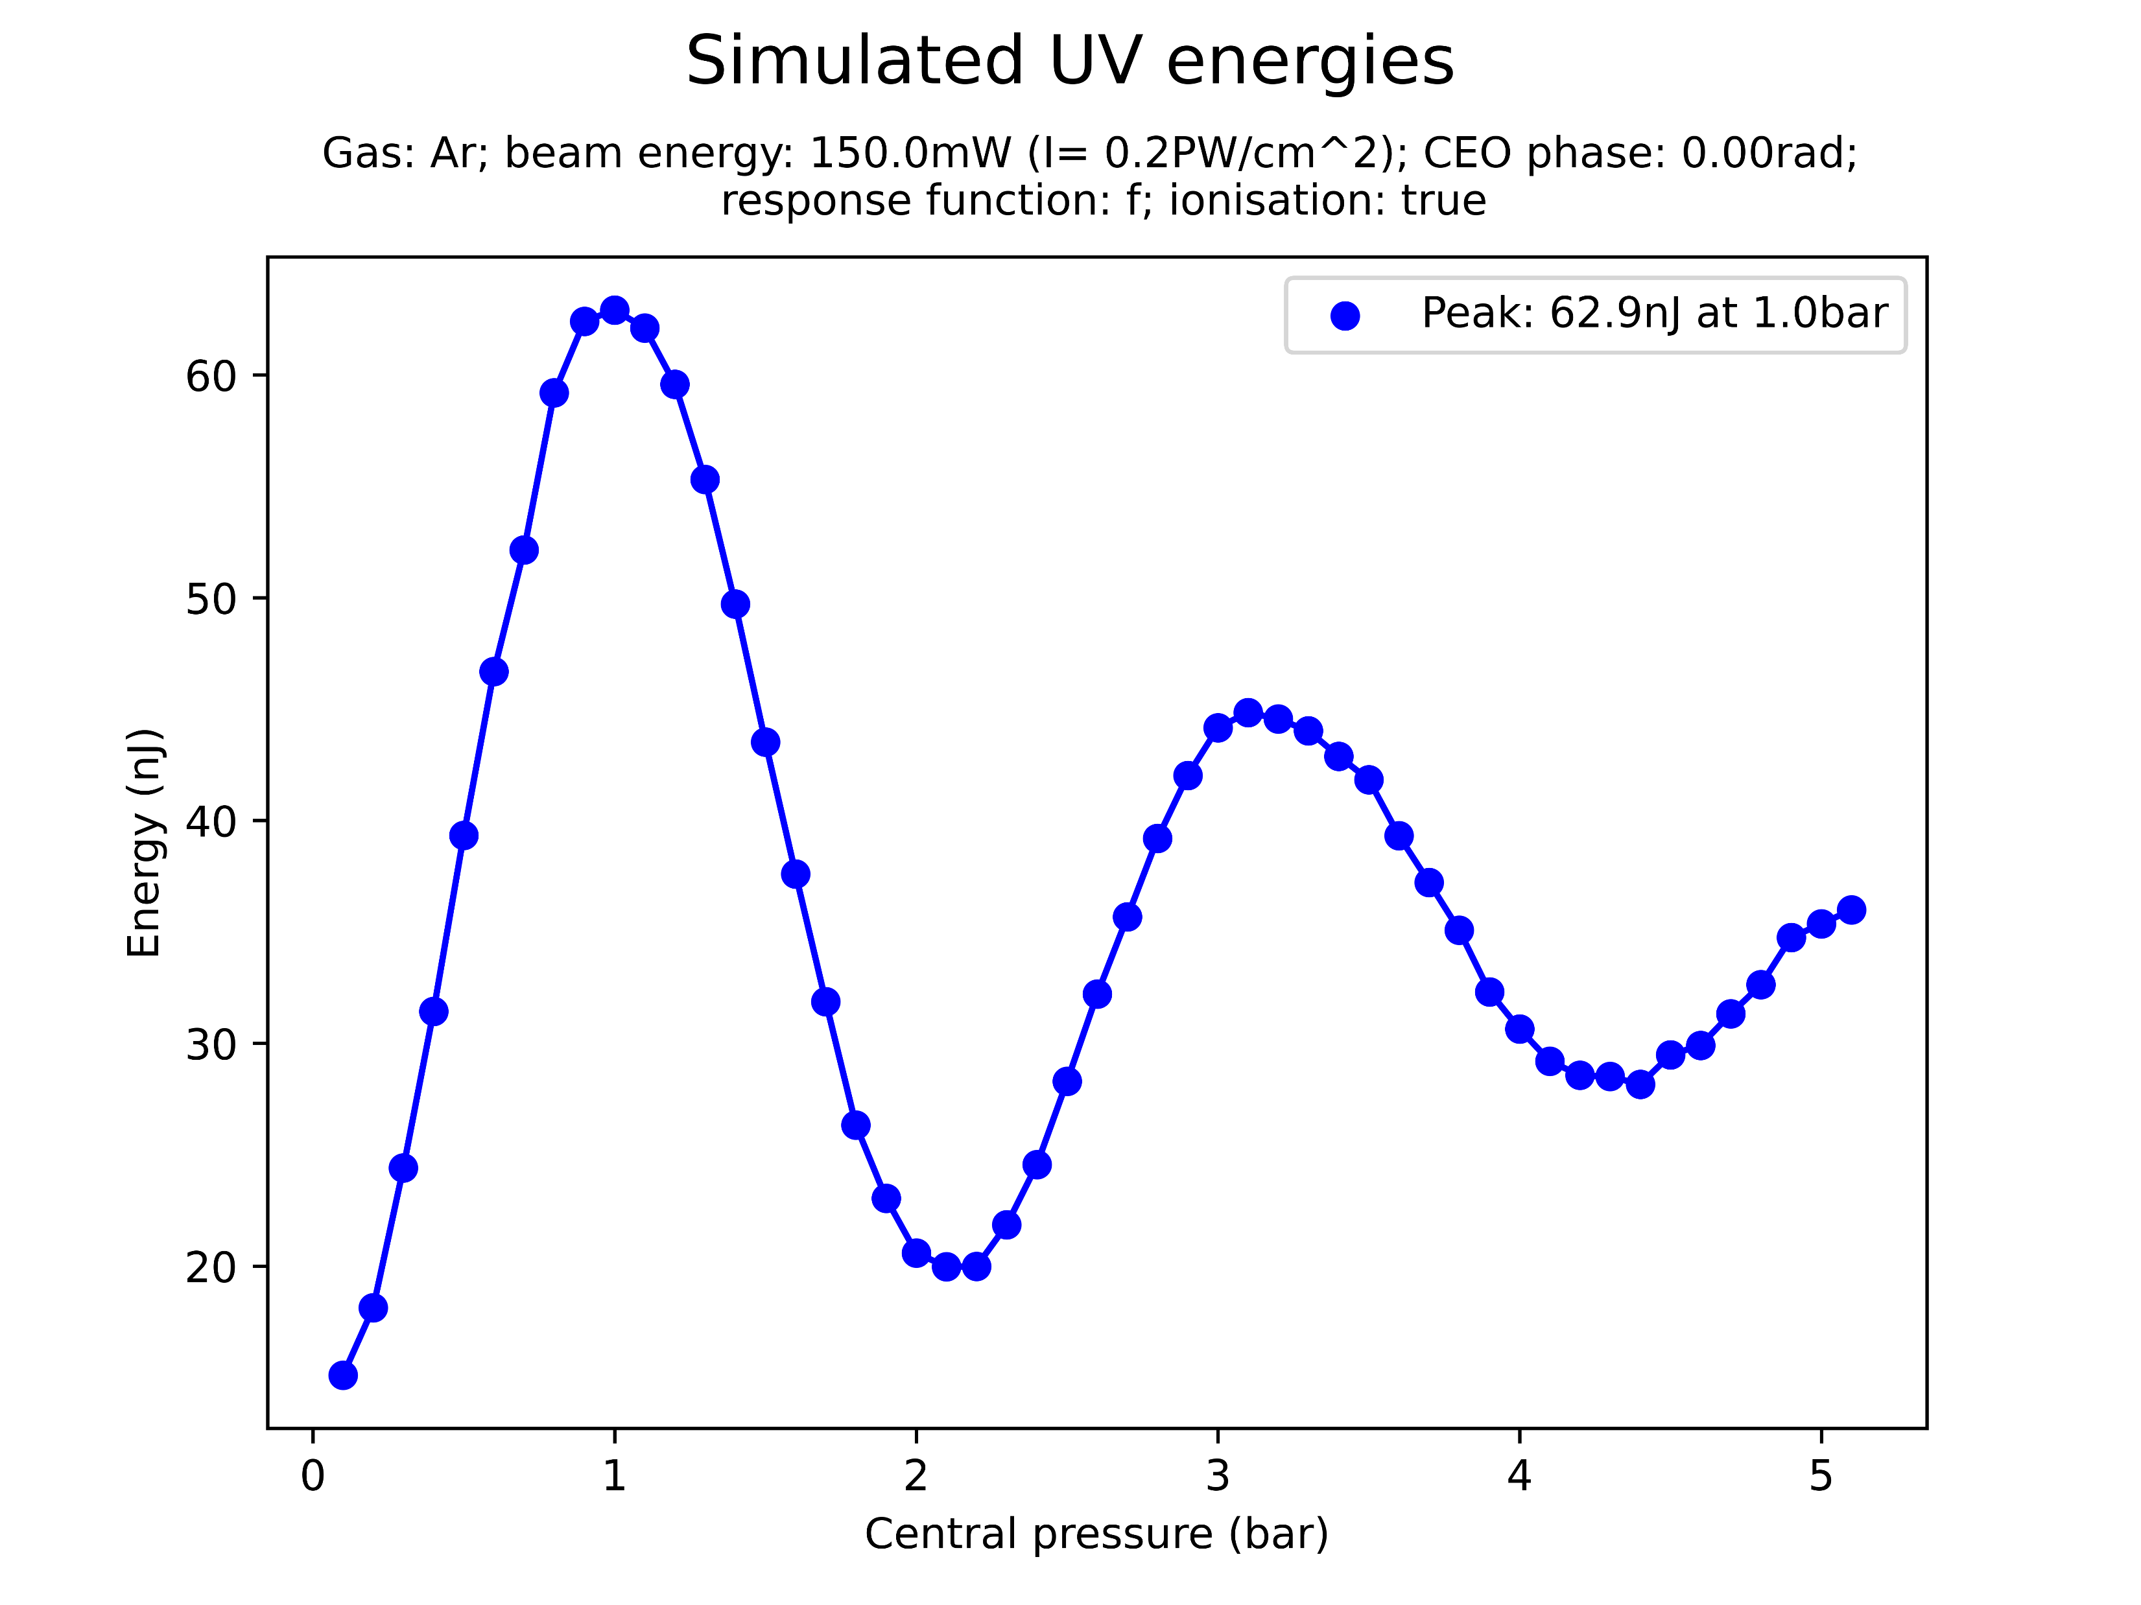
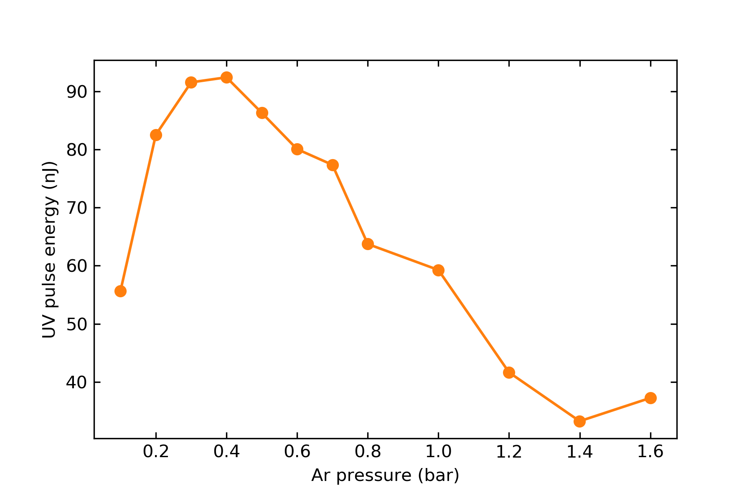
Using the COMSOL model has a significant effect on the UV output energy, which is reduced by an order of magnitude
This is likely to be due to effects outside the gas cell itself (the COMSOL model includes 3.5cm on either side of the cell)
Investigate a “truncated” COMSOL model only within the actual cell and compare?
The COMSOL model is much closer to the measured UV energies than the gradient model
Ar 150mW

Slide 8
Comparison of different gases

Slide 9
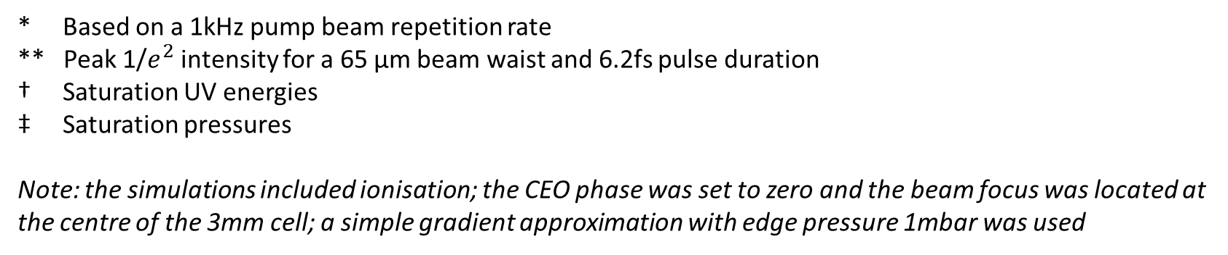
Relative Neon/Argon saturation values [OLD]
Beam power* | Beam peak intensity** | E_Ne/E_Ar † | P_Ne/P_Ar ‡
75mW | 0.091 PW/cm^2 | 0.945 | 11.591
150mW | 0.182 PW/cm^2 | 2.302 | 11.588
200mW | 0.243 PW/cm^2 | 2.871 | 10.688
300mW | 0.365 PW/cm^2 | 3.376 | 10.143
* Based on a 1kHz pump beam repetition rate
** Peak 1/$e^{2}$ intensity for a 65 µm beam waist and 6.2fs pulse duration
† Saturation UV energies
‡ Saturation pressures
Note: the simulations included ionisation; the CEO phase was set to zero and the beam focus was located at the centre of the 3mm cell; a simple gradient approximation with edge pressure 1mbar was used

Slide 10
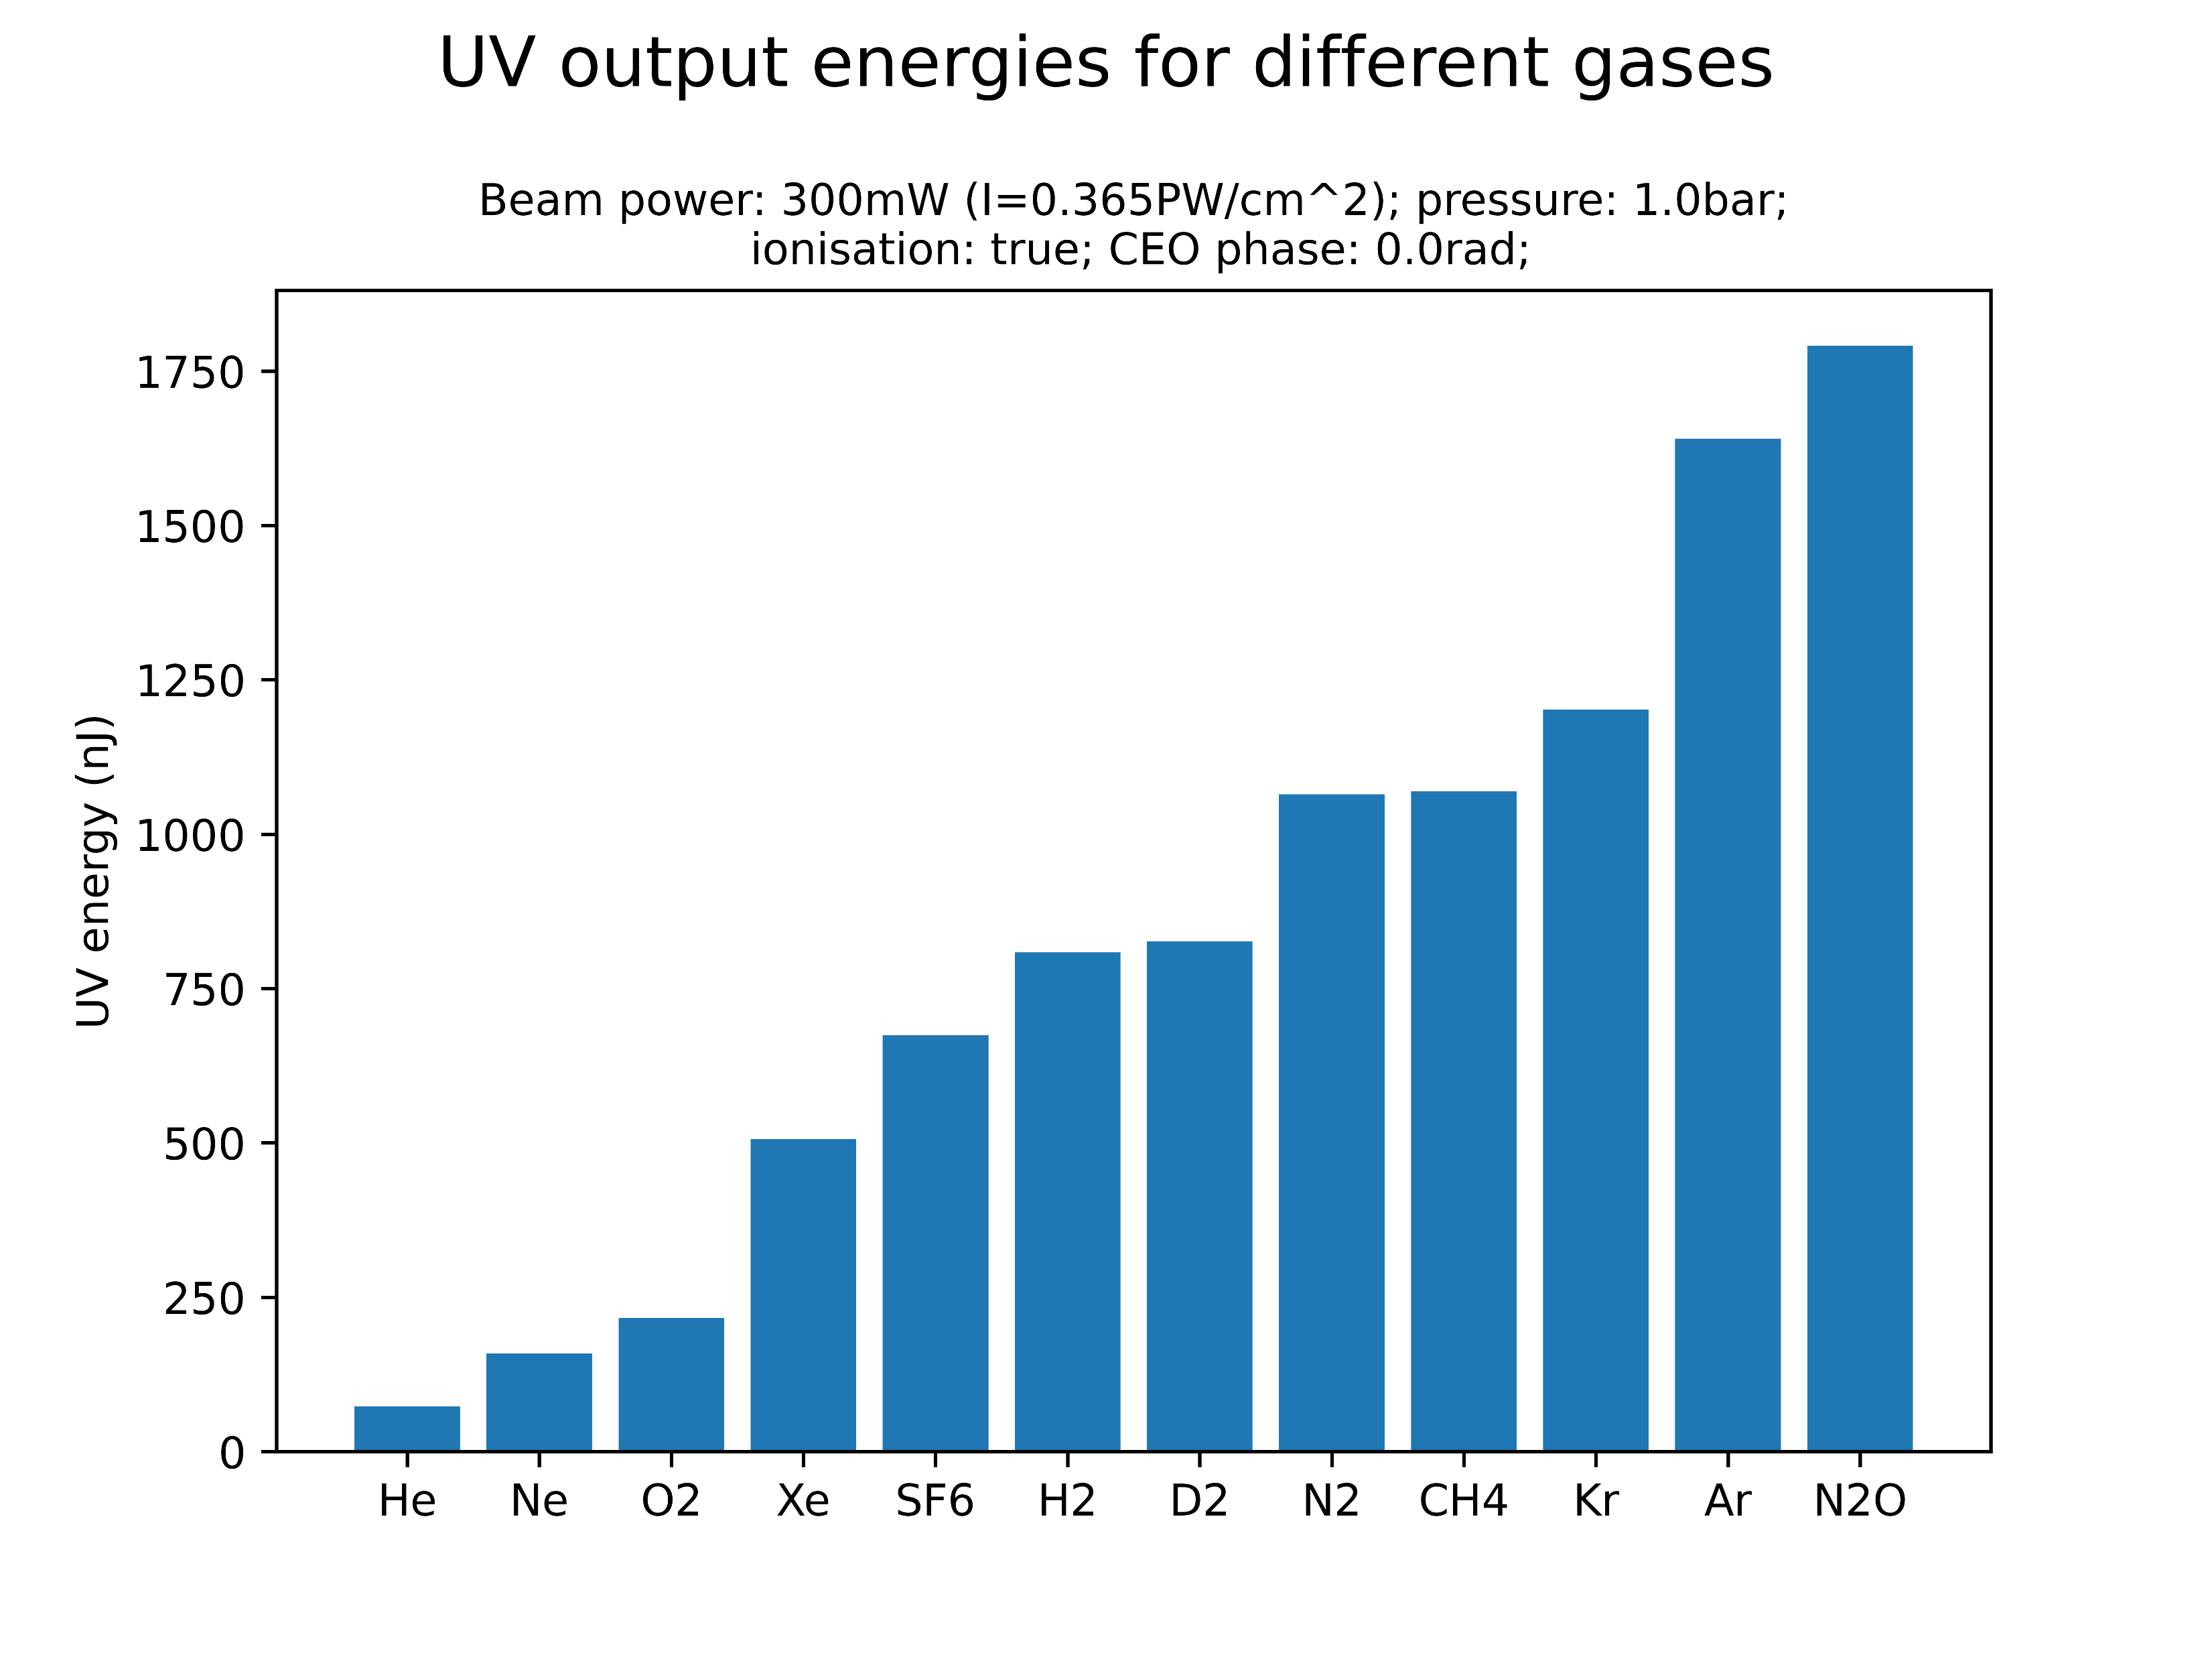
Comparison of different gases [OLD]
At the given parameter values, the highest UV energies are generated by krypton, argon and nitrous oxide
Investigate Kr and N2O in more detail (plots on Sync&Share)?
Neon, on the other hand, yields the second-lowest UV energy
Note that relative gas performance is likely sensitive to central gas pressure and beam power: simulations should be extended!

